Slide 1
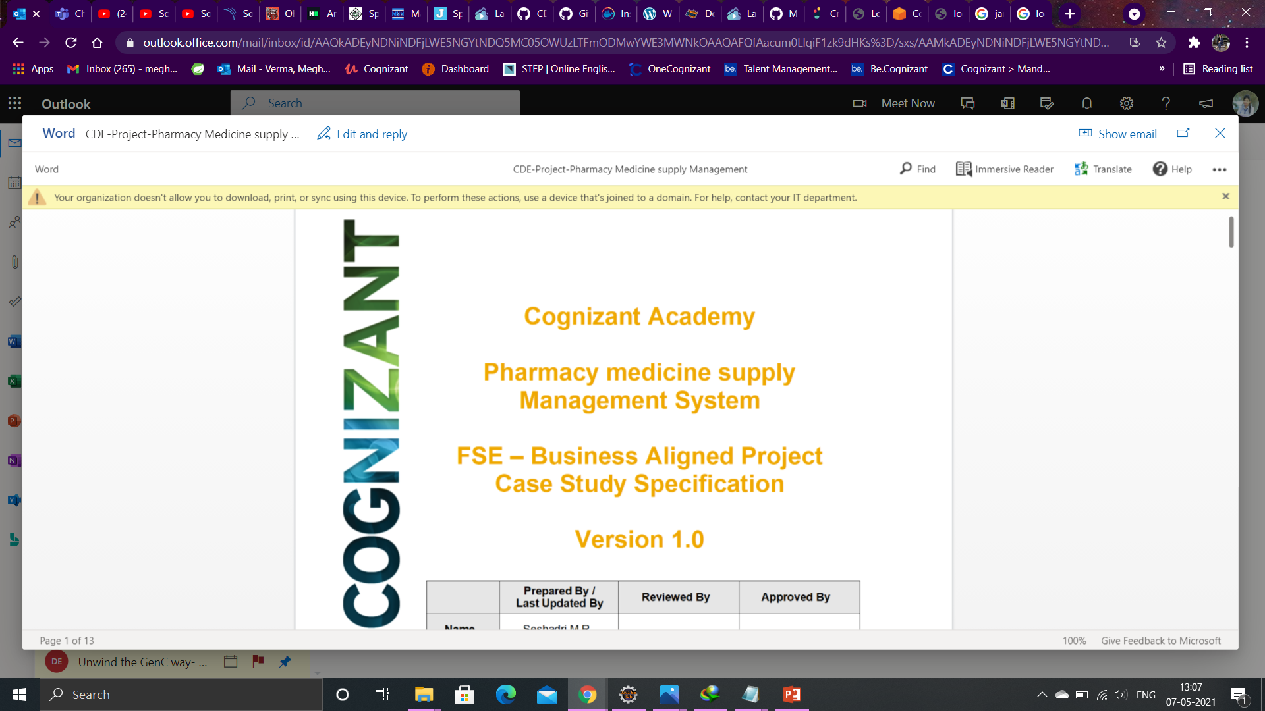
CDE20IJ015
MFPE-POD5

Slide 2

Pharmacy Medicine Supply Management System

Slide 3
Team Details
Subhodeep Seal(897005)
Priyanka Priyadarsini(897010)
Meghna Verma(897016)
Natansh Upadhyay(896879)

Slide 4
Index
Introduction
Software & Hardware Requirements
Technologies used
System Architecture and Diagram
Micro Services
Junit Testing
Deployment to Cloud
E2E testing
Conclusion

Slide 5
Introduction
Our app is designed for a Pharmaceutical Company to
Schedule the Medical Representatives,
Order medicines from the available stock ,
With proper validations.
We have used 5 different micro services to perform different operations as mentioned in the SRS.

Slide 6
Software & Hardware Requirements:
1. Hardware Requirements:
a. Developer Desktop PC with 4/8 GB RAM
2. Software Requirements:
a. Spring Tool Suite (STS) Or any Latest Eclipse
b. Maven
c.Postman Client in Chrome

Slide 7
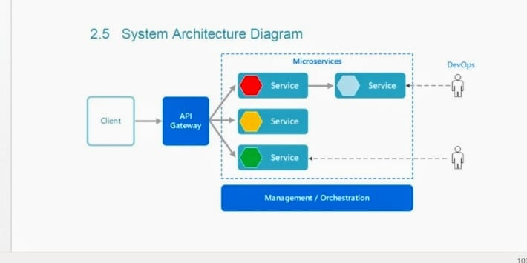
System Architecture & Diagram

Slide 8
Technologies Used
AWS server
In-memory H2 Database
Postman
Java
Spring Boot
Jpa
Bootstrap
HTML

Slide 9
MICROSERVICE FLOW
Token Generation
Check Stock
Success
Medicine Stock
Medicine Supply
Authorization Microservice
Medical Representative
Pharmacy portal

Slide 10
MICROSERVICES INTERACTION WH PORTAL
Medicine Supply
Pharmacy Portal
Representative Schedule
Medicine Stock

Slide 11
Login
Medical Representative
Medicine Stock
Logout
Information about medicine
schedule to have meetings with doctors

Slide 12
Micro Services
The micro services that are used in this application are:
Authorization Microservice
Medicine Stock Microservice
Pharmacy Medicine supply Microservice
Medical Representative Schedule Microservice
Pharmacy Medicine Supply portal

Slide 13

Authorization Micro Service
Token used for authorized access to the portal.
Proper Validation has been done in order to prevent unauthorized access.

Slide 14
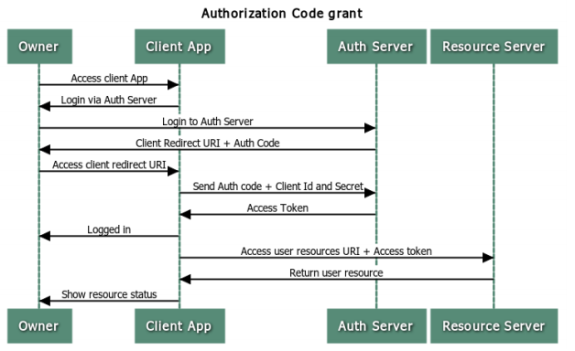
AUTHORIZATION SEQUENCE :

Slide 15

Medicine Stock Micro Service
This micro service provides information like:
name of the medicine, chemical composition, target aliment, date of expiry.

Slide 16
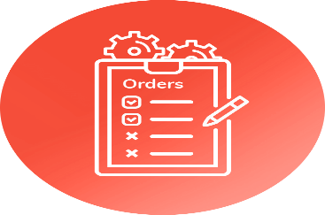



Pharmacy Medicine Supply Micro service
Allows the user to place order.
Input : Medicine count from web portal
Connects with Medicine Stock service to get the current stock.
Places the order accordingly.

Slide 17

Medical Representative Schedule Micro service
The intent of this Micro service is to provide a doctor meet schedule for the Representatives of the company.
It allows the user to check on which date which representative is available.

Slide 18
Pharmacy medicine supply Portal
Pharmacy medicine supply Portal allows a member to Login with credentials Then have the following options :
-Medical representatives’ schedule
-Order Medicine
-Check Medicine stock
-Check Medicine demand

Slide 19
USER INTERFACE

Slide 20
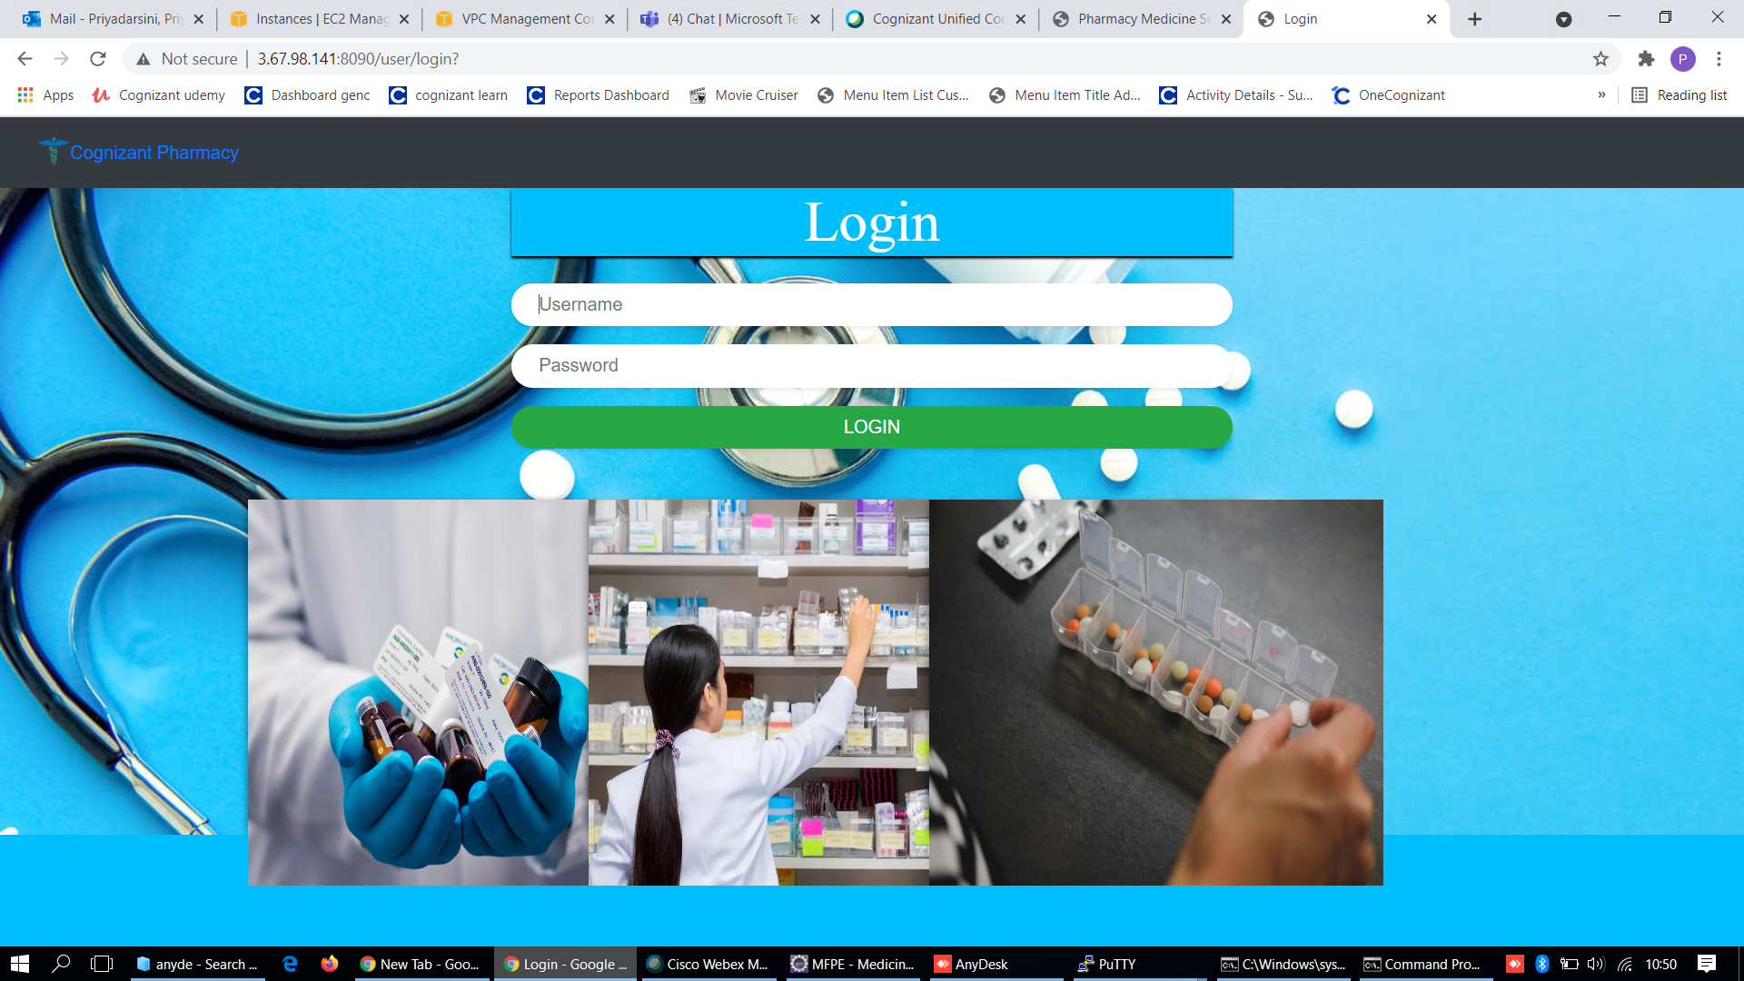
Login page

Slide 21
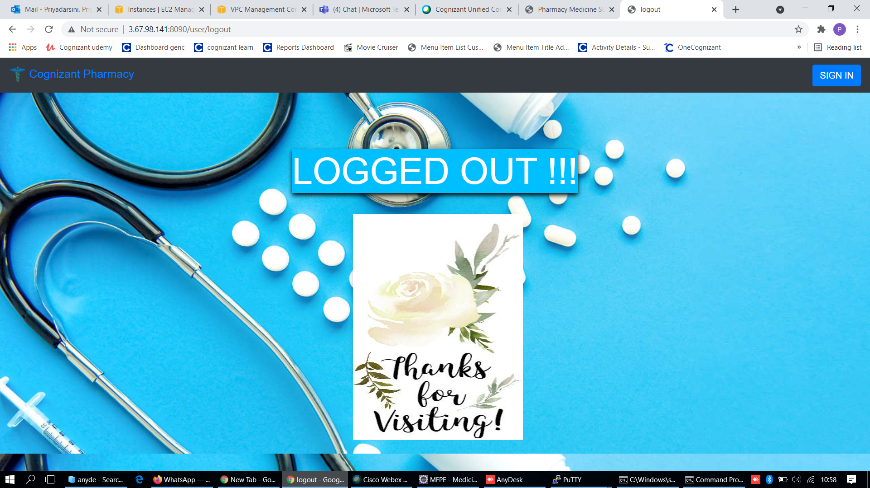
Logout page

Slide 22
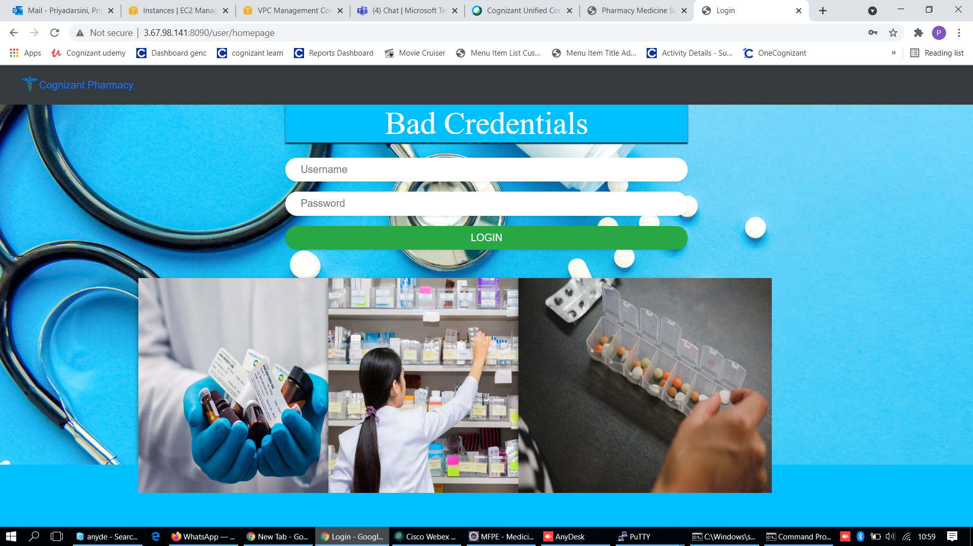
Validation

Slide 23
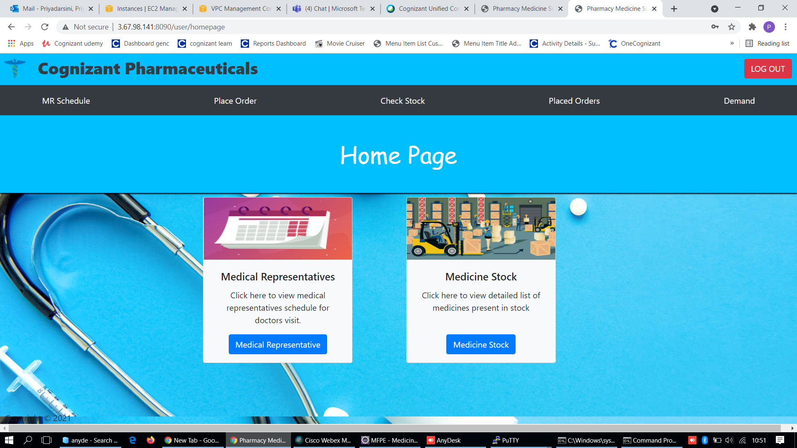
Home Page

Slide 24
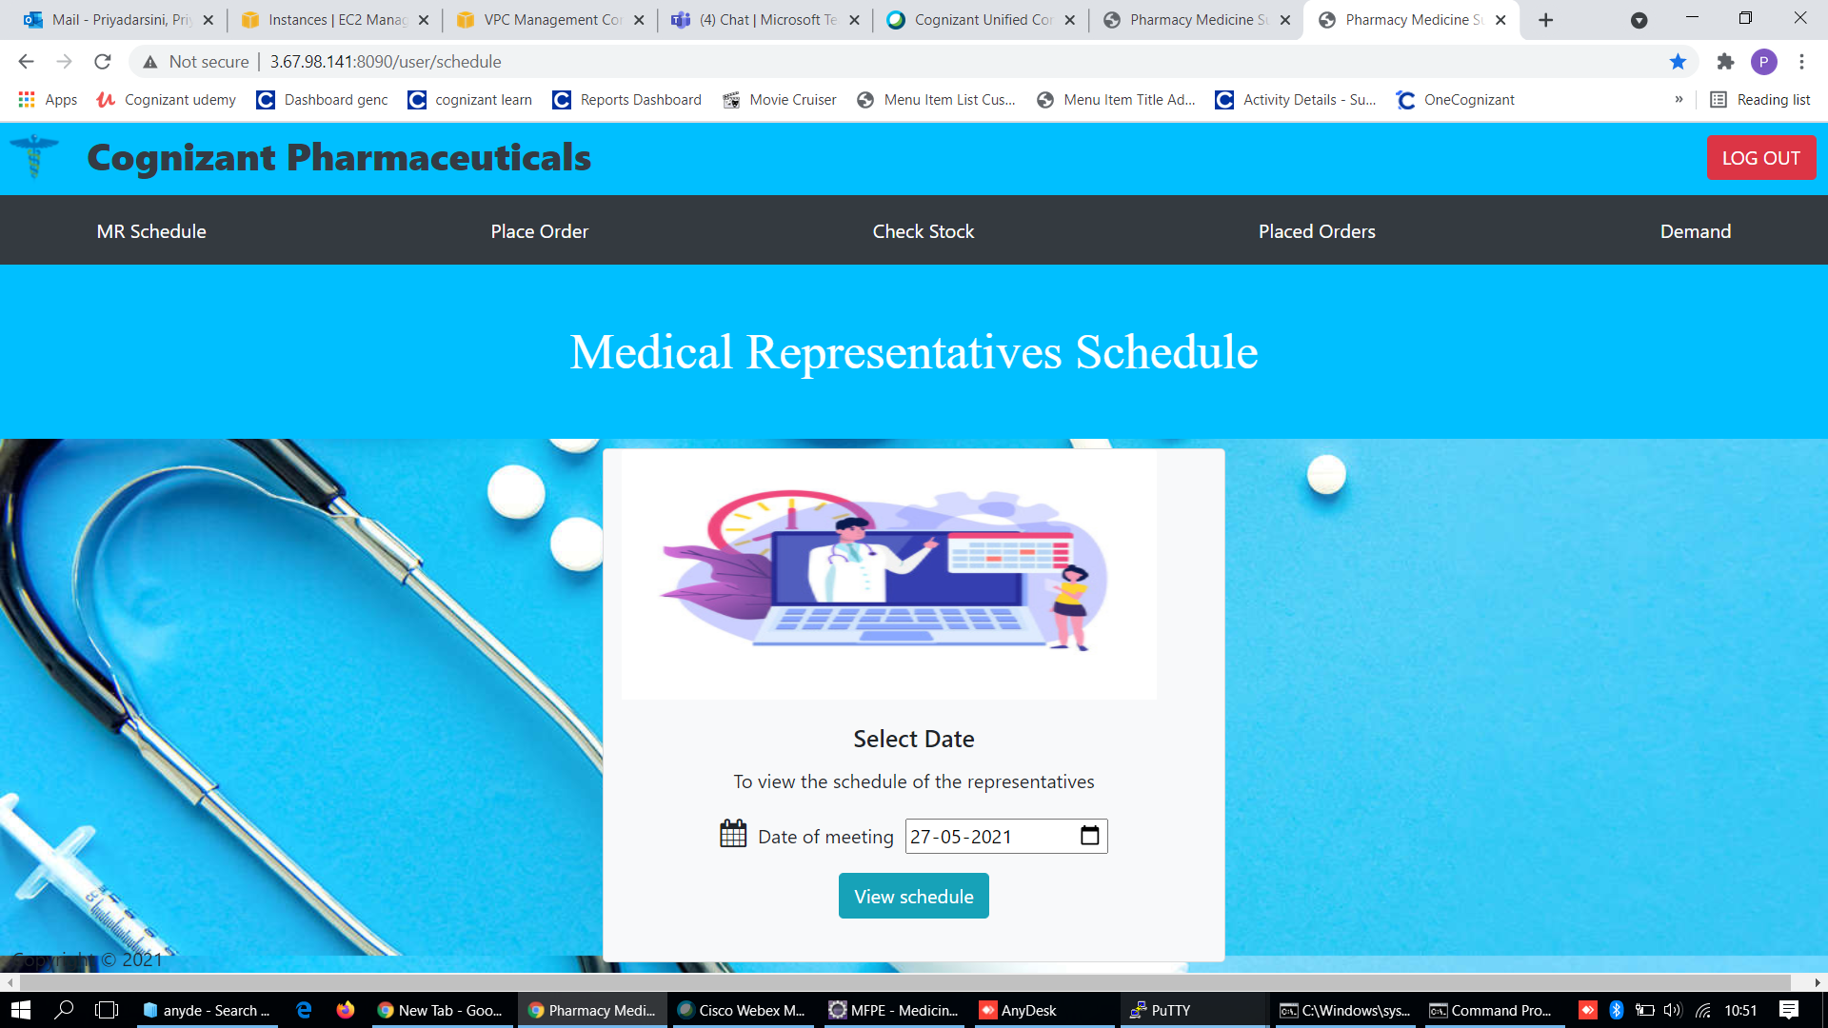
MR Schedule

Slide 25
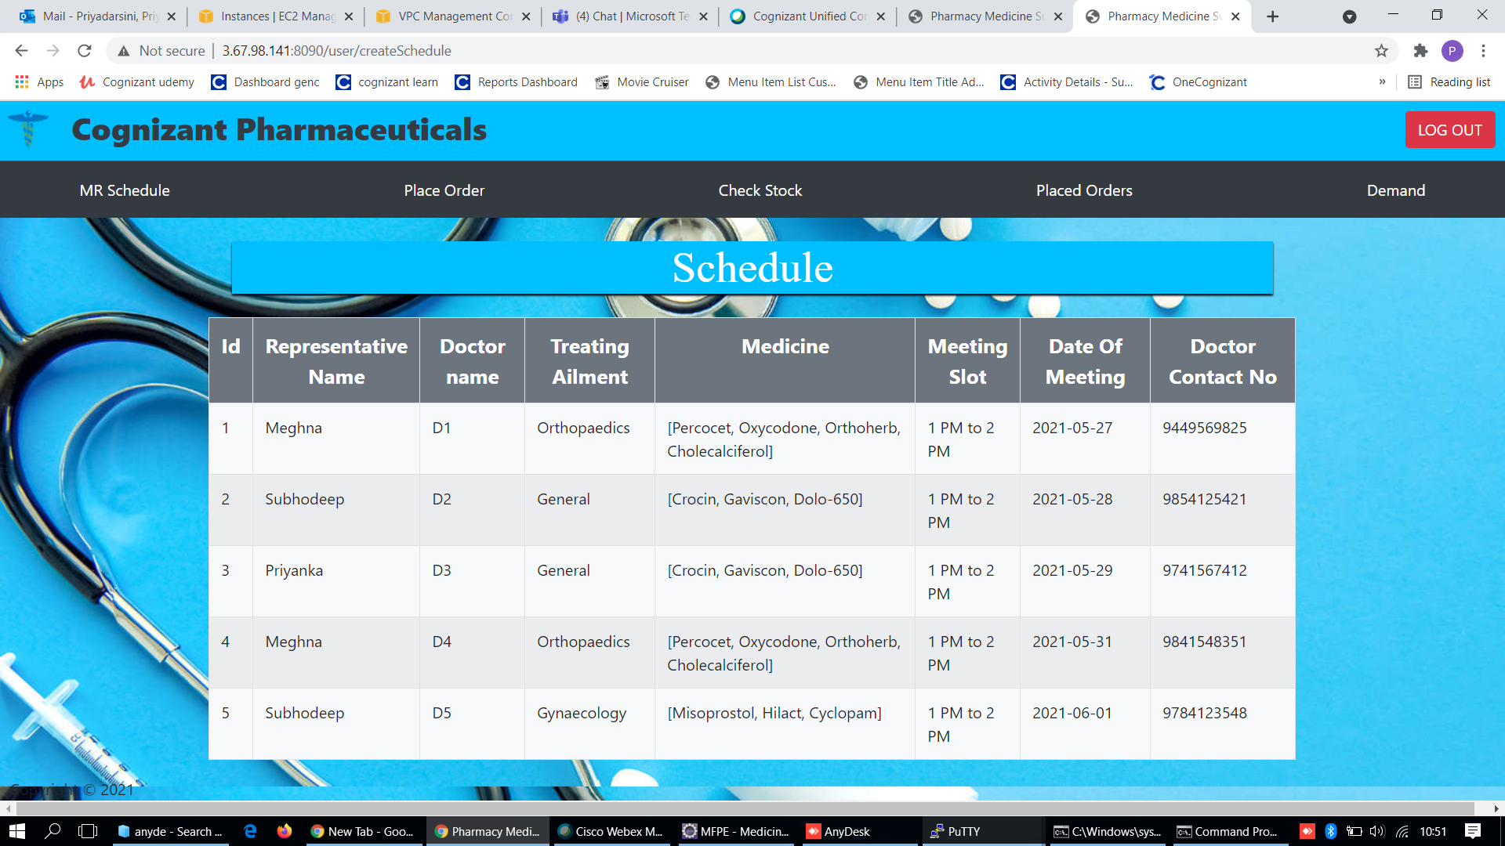
MR Schedule

Slide 26
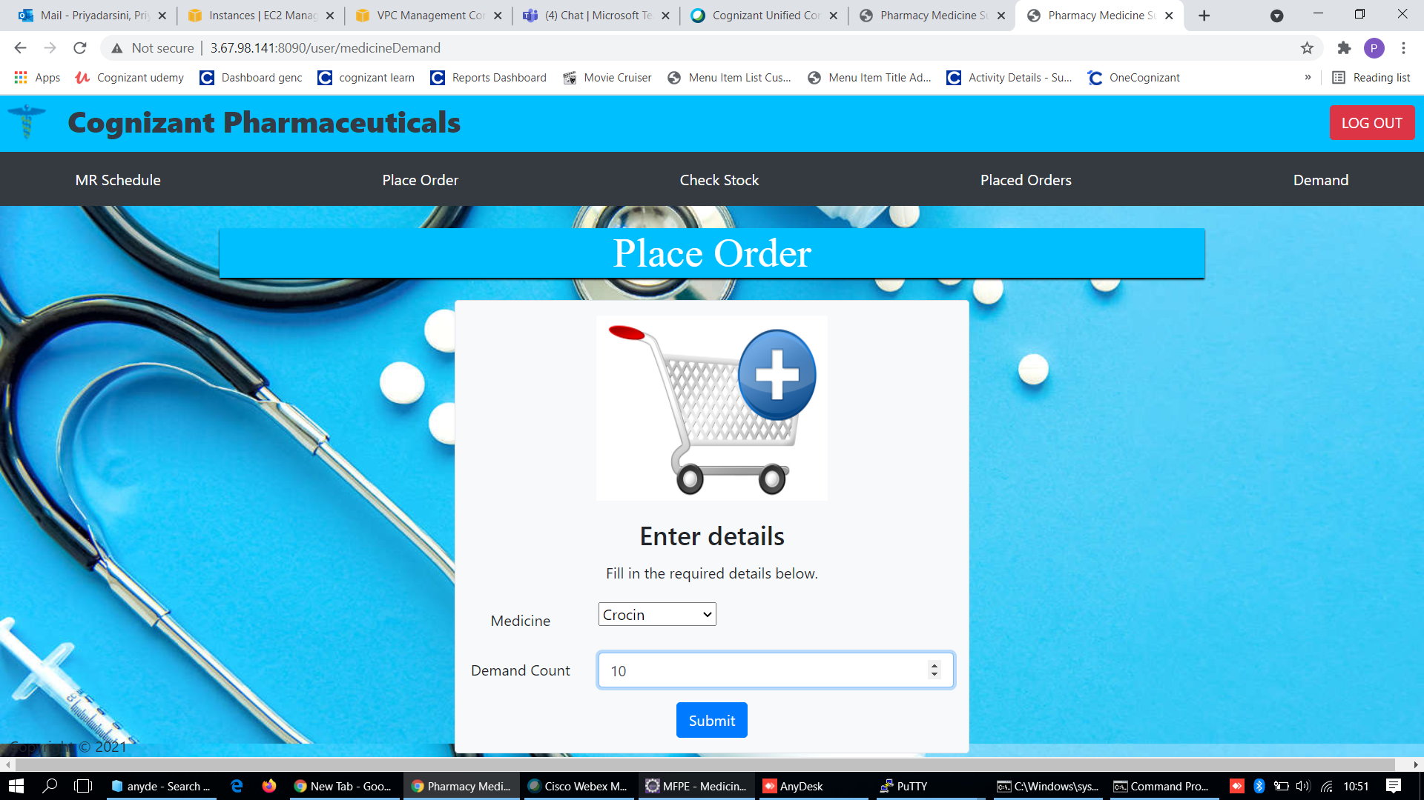
Order placed

Slide 27
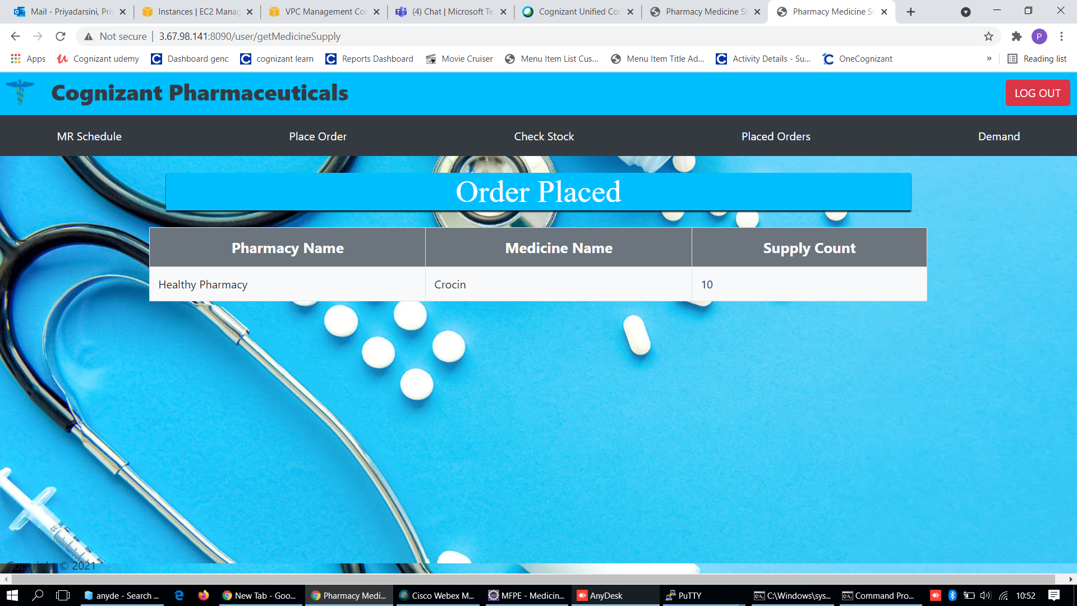
Placed Order

Slide 28
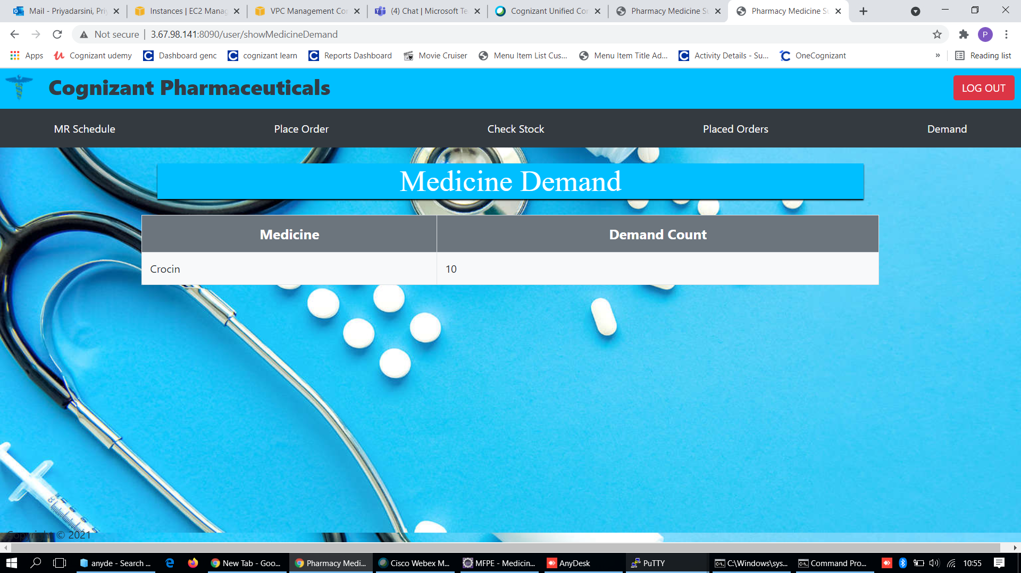
Medicine Demand

Slide 29
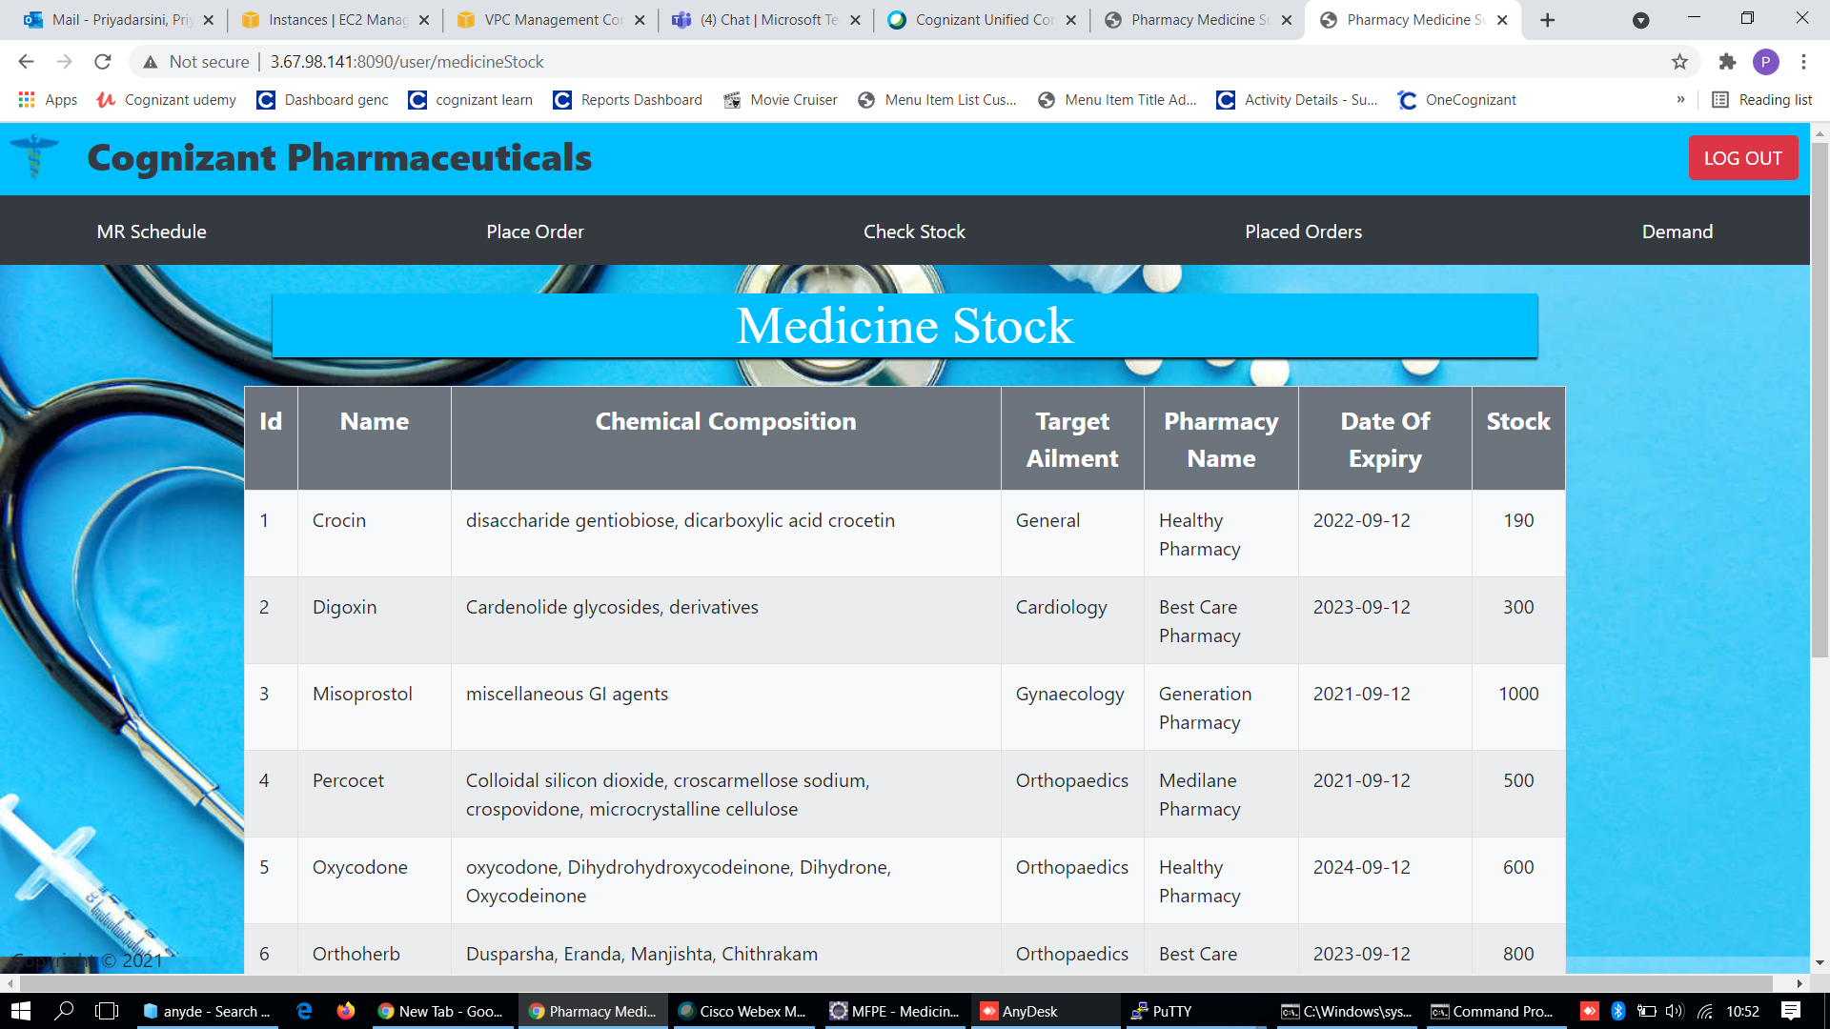
Medicine Stock

Slide 30
JUnit Testing
JUnit is an open source Unit Testing Framework for JAVA.
As the name implies, it is used for Unit Testing of a small chunk of code.
After we were done with code, we executed all tests.
Every time any code was added, we re-executed all test cases and made sure nothing is broken.

Slide 31
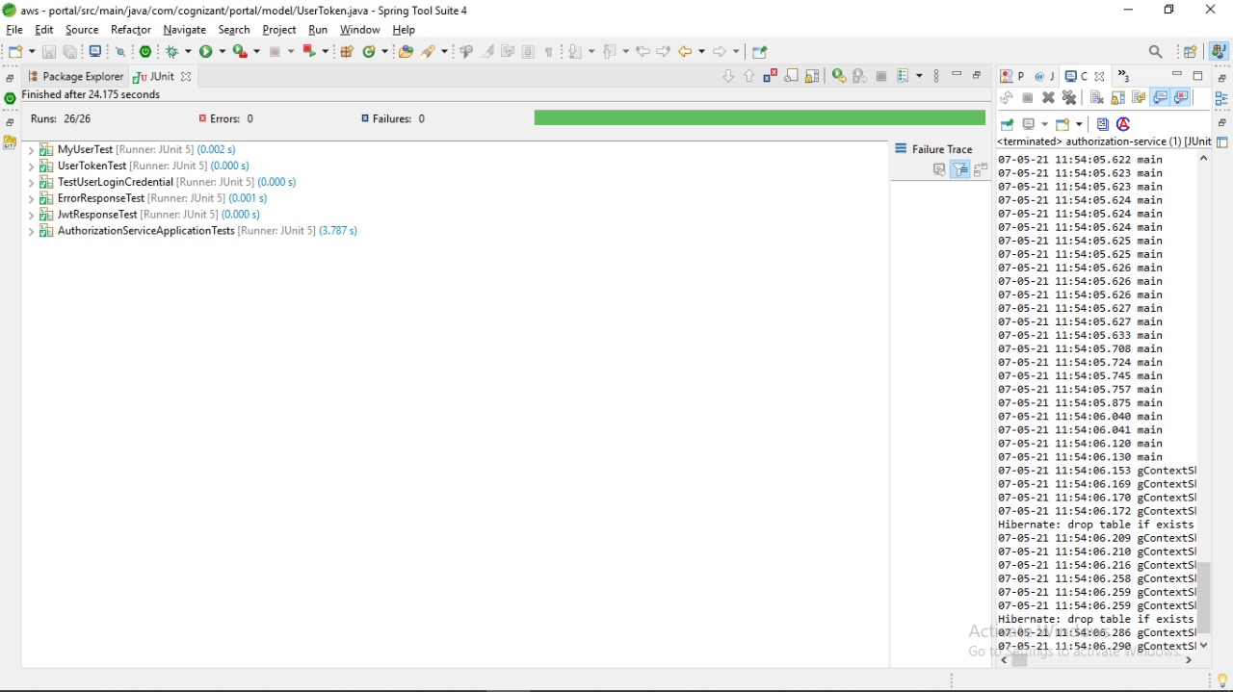
JUNIT TESTING :

Slide 32
Cloud Deployment
All the Micro services are deployed in Cloud
· All the Micro services are independently deployed.
We have used EC2 instance to rent virtual computer because:
1) Complete Control with Ease of Access
2) Ability to Select a Platform of our Choice
3) Secure

Slide 33
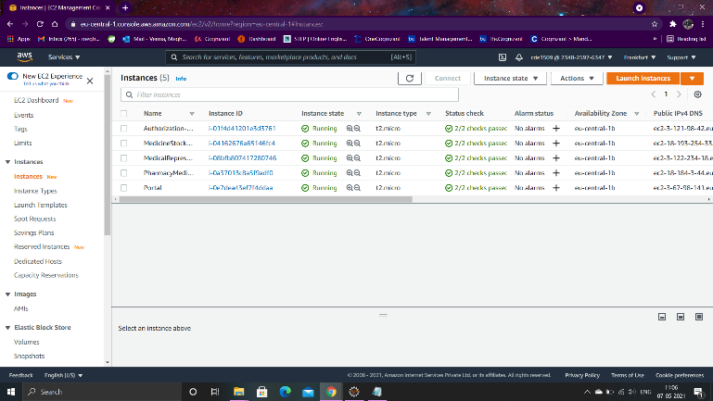
Cloud Deployment

Slide 34
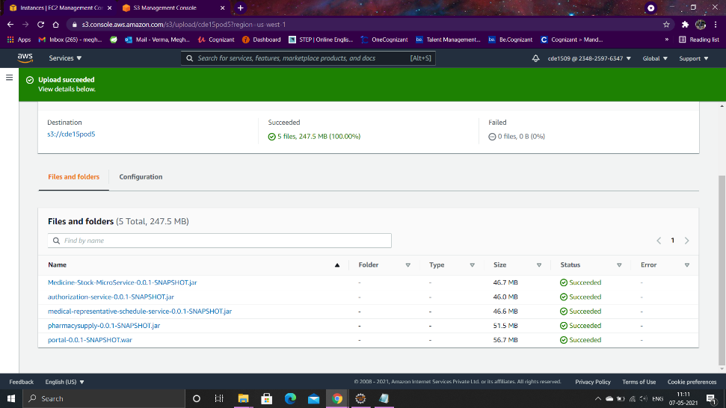

Slide 35
E2E Testing
End to end testing (E2E) testing done to check application's workflow.
We have done testing on all the modules by analyzing the functionalities.

Slide 36
Conclusion :
Implemented Pharmcy medicine supply management system using micro service architecture.
Successfully implemented backend using Spring Boot and MVC.
Gained insight over frontend using JSP, HTML, and Bootstrap.
Successfully learned to deploy in cloud using AWS.

Slide 37

Health is Wealth !!
So, take care of yourself.

